Slide 1

CompSci 471
3.1
→
6.5
→
9.0
→
+10
Artificial Intelligence
-0.2
↑
WALL
4.9
↑
-10
Lesson 13: Reinforcement Learning I
Value Iteration
-3.4
→
-0.6
→
1.7
↑
-1.2
←
Value iteration improves what we believe about the present
using what we currently believe about the future.
Values become a heat map.
Initialize
V(s)
→
Bellman
backup
↓
↓
Value iteration loop
Measure
change
→
Repeat until
converged
Fall 2026
CS 471 | L13: Value Iteration
1
Notes:
Open by connecting L11 and L12 to computational solution methods. Value iteration is the first algorithm that computes values from the MDP model. Keep the theme: repeated backups until values stabilize.
Emphasize that the numbers are estimates that become more informative through repeated backups.

Slide 2
Quiz 3
Individual work, 10 minutes to demonstrate the MDP foundations.
Before you begin
Put away devices
Use only allowed materials
Write clearly and show work when requested
Focus
L11 MDP components
L12 policy, return, and value
Conceptual distinctions
After quiz
Return to the Gridworld
Values will start changing
Bellman updates begin
After quiz: Where do the values in a Gridworld actually come from?
CS 471 | L13: Value Iteration
2
Notes:
Reminder. After, we move from defining MDPs and values to computing values with Bellman backups.

Slide 3
Today’s mission
Policy and value give meaning to behavior over time.
1
Explain how value iteration works.
2
Apply a Bellman update to a simple state.
3
Interpret convergence of value estimates.
Performance target: given transition probabilities, rewards, a discount factor, and current state values, calculate updated action/state values and explain what repeated small changes indicate.
CS 471 | L13: Value Iteration
3
Notes:
Emphasize that students should be able to execute a small Bellman calculation and explain the algorithm, not simply recognize vocabulary.

Slide 4
Retrieval: what did the numbers mean?
Previous lesson gave the meaning of value before we compute it.
3.1
→
6.5
→
9.0
→
+10
Quick check
Is 6.5 an immediate reward?
-0.2
↑
WALL
4.9
↑
-10
Is it one lucky trajectory?
-3.4
→
-0.6
→
1.7
↑
-1.2
←
What does it summarize?
Policy arrows and state values
A value summarizes expected long-term return from a state.
CS 471 | L12: Policies, Return, and Value
4
Notes:
Use this as a quick bridge after the quiz. Students should recall that value summarizes expected cumulative return; today they see how an algorithm estimates it.

Slide 5
The question L12 left unanswered
We know what value means. Where do the numbers come from?
?
?
?
+10
3.1
→
6.5
→
9.0
→
+10
?
WALL
?
-10
-0.2
↑
WALL
4.9
↑
-10
?
?
?
?
-3.4
→
-0.6
→
1.7
↑
-1.2
←
Value estimates unknown
Value estimates after repeated updates
Value iteration fills in the map by repeatedly looking one step ahead.
CS 471 | L13: Value Iteration
5

Slide 6
Math checkpoint: probability-weighted future value
L11 read transition probabilities. L13 uses them.
One action can lead to several futures
Outcome
Probability
Value
Stable
0.75
6
0.75(6) + 0.25(2) = 5
Strained
0.25
2
Multiply each future value by how likely that future is, then add.
This is the probability skill value iteration needs.
CS 471 | L13: Value Iteration
6
Notes:
This is the just-in-time probability refresher. Do not teach broad probability; simply motivate expected value from transition outcomes.

Slide 7
A Bellman backup is one-step lookahead
Local structure: agent choice followed by environment uncertainty.
state s
choose East
CHANCE
0.10
slip North
V=2.0
0.80
go East
V=8.0
0.10
slip South
V=4.0
Bellman replaces a deep tree with one-step lookahead plus reusable state values.
CS 471 | L13: Value Iteration
7
Notes:
Keep this intuitive before showing notation. Bellman is a one-step lookahead: reward now plus value of the likely next states.

Slide 8
The Bellman idea before the equation
An action has an immediate consequence and leaves us in a future situation.
Immediate reward
What happens now?
Discounted expected
future value
Action value
Q(s,a)
+
Question: What do I get now, and what valuable situation am I likely to reach?
CS 471 | L13: Value Iteration
8

Slide 9
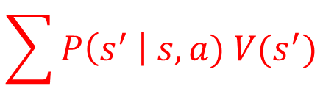
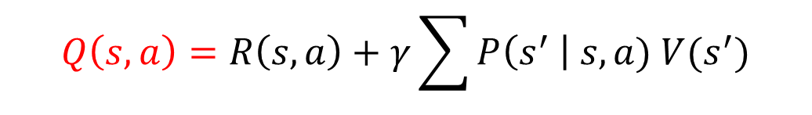
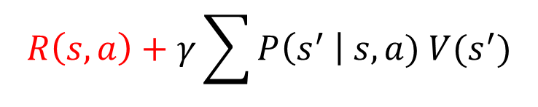
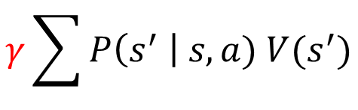
Build the Bellman action value
One equation, assembled one idea at a time.
$$\sum{P\left(s^{′} \right| s, a) V(s^{′})}$$
Expected future value
Discount future value
$$γ\sum{P\left(s^{′} \right| s, a) V(s^{′})}$$
Add immediate reward
$$R\left(s, a\right)+γ\sum{P\left(s^{′} \right| s, a) V(s^{′})}$$
Action value
$$Q\left(s, a\right)=R\left(s, a\right)+γ\sum{P\left(s^{′} \right| s, a) V(s^{′})}$$
Q(s,a) estimates the long-term value of taking action a in state s.
CS 471 | L13: Value Iteration
9
Notes:
Use notation gradually. For this lesson, use R(s,a) as the immediate reward form to keep calculations aligned with the assessment style.

Slide 10
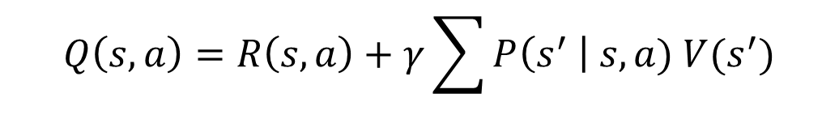
Read the equation in English
The notation is a compact version of the story.
$$Q\left(s, a\right)=R\left(s, a\right)+γ\sum{P\left(s^{′} \right| s, a) V(s^{′})}$$
Term
Meaning
Q(s,a)
value of taking action a here
R(s,a)
immediate reward
γ
future-reward weight
P(s′|s,a)
chance of each next state
V(s′)
current estimate of next state value
A Bellman backup is immediate reward plus discounted expected future value.
CS 471 | L13: Value Iteration
10
Notes:
Have students read the equation aloud in plain English. The goal is interpretation, not symbolic manipulation.

Slide 11
Worked backup: evaluate one action
Zoom into one Gridworld state and one action.
State
Top row, one cell left of +10
0.0
0.0
0.0
+10
Action
East
0.0
WALL
0.0
-10
Model
0.80 → +10 terminal
0.10 → stay in same cell
0.10 → move south
0.0
0.0
0.0
0.0
Reward
living reward = −1 if not terminal
Current estimates V₀
First compute expected future value.
Then add reward and discount.
CS 471 | L13: Value Iteration
11
Notes:
Set up the example before doing arithmetic. Ask students which numbers are probabilities, which number is reward, and which are current value estimates.

Slide 12
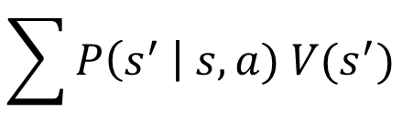
$$\sum{P\left(s^{′} \right| s, a) V(s^{′})}$$
Step 1: expected future value
Average over environment outcomes.
0.80(10) + 0.10(0) + 0.10(0)
0.0
0.0
0.0
+10
= 8.0
0.0
WALL
0.0
-10
Interpret
If East is attempted,
the successor situation has expected future value 8.0 under the current estimates.
0.0
0.0
0.0
0.0
Predict
If the south cell becomes more valuable later, this action value may increase.
Do not stop at arithmetic. Explain what the intermediate number represents.
CS 471 | L13: Value Iteration
12
Notes:
Make sure students do not skip the probability-weighted future value step. This is the expected future value before discounting.

Slide 13
Step 2: discount the future & Step 3: add the reward
Now convert the expected future into an action value.
Q(s, East) = R + γ(expected future value)
0.0
0.0
0.0
+10
= 0 + 0.90(8.0) = 7.2
0.0
WALL
0.0
-10
Meaning
7.2 is the current long-term value estimate for trying East in this state.
0.0
0.0
0.0
0.0
Not meaning
It is not the immediate reward and not a guaranteed outcome.
Action values summarize immediate and future consequences.
CS 471 | L13: Value Iteration
13
Notes:
Reinforce that gamma is not a probability. It is the discount factor, already introduced in L12.
State clearly that the Bellman action value is not the reward received immediately. It is a long-term estimate that uses current value estimates.

Slide 14
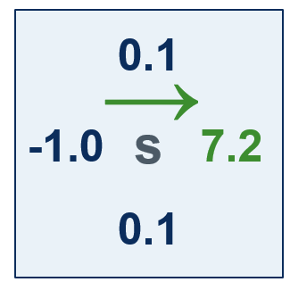
A state has choices
A Bellman backup evaluates all available actions, then chooses the best one.
For this state
0.0
0.0
+10
0.1
North: 0.1
→
0.0
WALL
0.0
-10
East: 7.2
-1.0
s
7.2
South: 0.1
0.1
0.0
0.0
0.0
0.0
West: −1.0
V₁(s) = maxₐ Q(s,a) = 7.2
The state value uses the largest action value because the agent chooses the action.
CS 471 | L13: Value Iteration
14
Notes:
This introduces the max over actions. Ask students why Start Generator is not selected here even though it sounds safer. The answer is: in this table, its Bellman value is lower.

Slide 15
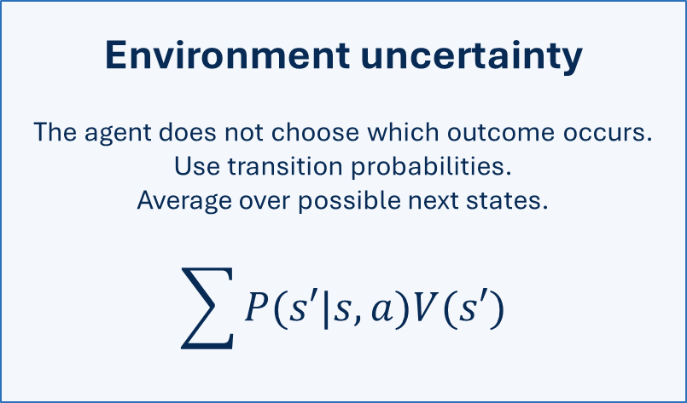
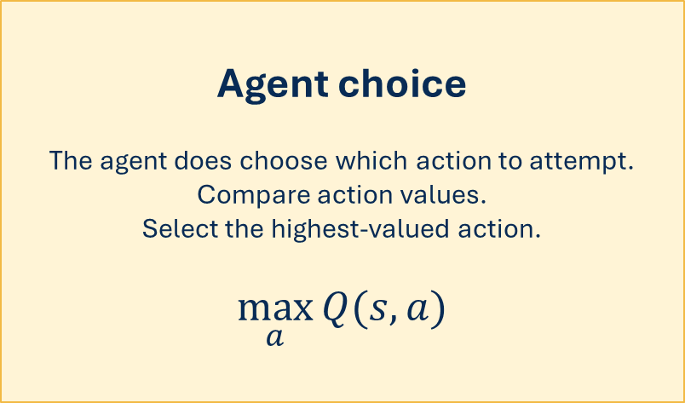
Environment averages; agent maximizes
This is why the Bellman update contains both Σ and max.
Environment uncertainty
The agent does not choose which outcome occurs.
Use transition probabilities.
Average over possible next states.
$$\sum{P(s′|s,a)V(s′)}$$
Agent choice
The agent does choose which action to attempt.
Compare action values.
Select the highest-valued action.
$$\max_{a}{Q(s,a)}$$
Sum handles chance. Max handles control.
CS 471 | L13: Value Iteration
15
Notes:
Students often mix up the summation and the max. Make explicit: probabilities apply to outcomes after an action; max applies to the agent selecting an action.

Slide 16
The Bellman optimality update
Predict → Evaluate → Choose.
$$Vₖ₊₁(s) = \max_{a}{ [R(s,a) + γ \sum{P(s′ | s,a)Vₖ(s′)}]}$$
Predict
probability-weighted future values
Evaluate
reward + discounted future
Choose
largest action value
A value iteration sweep applies this update across the state space.
CS 471 | L13: Value Iteration
16
Notes:
This is the central equation. Keep returning to the three operations: predict, evaluate, choose. Emphasize that old values are used to create new values.

Slide 17
One backup is not value iteration
One local operation becomes an algorithm when repeated across states.
Bellman backup
Update one state estimate
Use current successor values
One local computation
Value iteration
Perform Bellman backups across the state space
Repeat sweeps
Stop when values stabilize
Backup = operation.
Value iteration = repeated backups until stable.
CS 471 | L13: Value Iteration
17
Notes:
This distinction prepares students for code interpretation and for distinguishing value iteration from policy iteration in later lessons.

Slide 18
Iteration 0: start with estimates
Initialization is a starting guess, not a claim about truth.
0.0
0.0
0.0
+10
0.0
WALL
0.0
-10
0.0
0.0
0.0
0.0
V₀: non-terminal state estimates start at 0
Zero means “no future value has propagated yet.”
CS 471 | L13: Value Iteration
18
Notes:
Start of value iteration loop. Students may misinterpret V0 = 0 as a factual value. Explain that initialization starts the iterative process.

Slide 19
Iteration 1: reward reaches nearby states
Cells next to terminal outcomes change first.
0.0
0.0
0.0
+10
-1.0
-1.0
7.8
+10
0.0
WALL
0.0
-10
-1.0
WALL
-1.0
-10
0.0
0.0
0.0
0.0
-1.0
-1.0
-1.0
-1.0
V₀
V₁
Why did the cell left of +10 jump first?
CS 471 | L13: Value Iteration
19
Notes:
Use this conceptual slide to explain why one sweep is not enough. Values become more informed as reward information propagates.

Slide 20
Iteration 2: information moves farther
States that can lead to valuable states become valuable too.
-1.0
-1.0
7.8
+10
-1.9
4.4
8.4
+10
-1.0
WALL
-1.0
-10
-1.9
WALL
3.6
-10
-1.0
-1.0
-1.0
-1.0
-1.9
-1.9
-1.9
-1.9
V₁
V₂
The value of the future is propagating backward through the grid.
CS 471 | L13: Value Iteration
20

Slide 21
Iteration 3: long-term consequences spread
Before revealing a value, predict which cells should improve next.
-1.9
4.4
8.4
+10
1.9
5.8
8.8
+10
-1.9
WALL
3.6
-10
-2.7
WALL
4.5
-10
-1.9
-1.9
-1.9
-1.9
-2.7
-2.7
1.3
-2.7
V₂
V₃
Predict: if a successor state becomes more valuable,
what happens to states that can reach it?
CS 471 | L13: Value Iteration
21

Slide 22
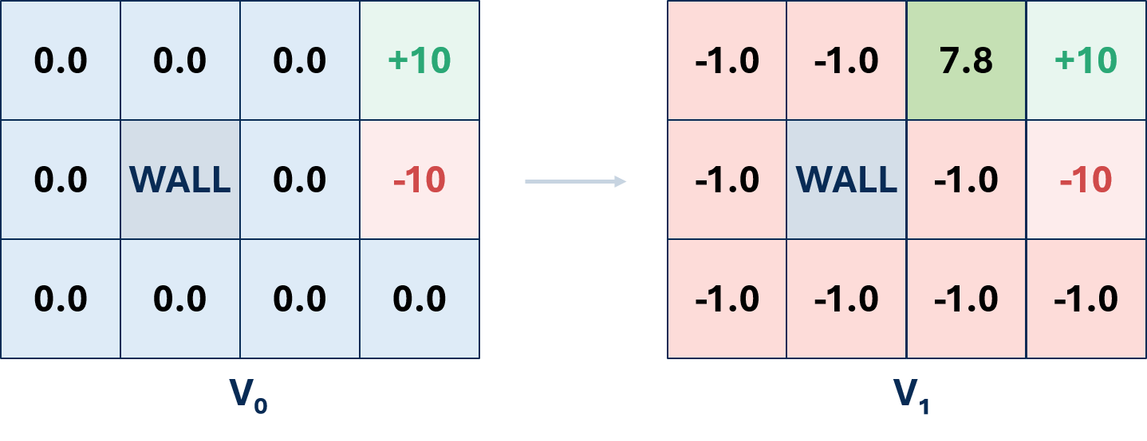
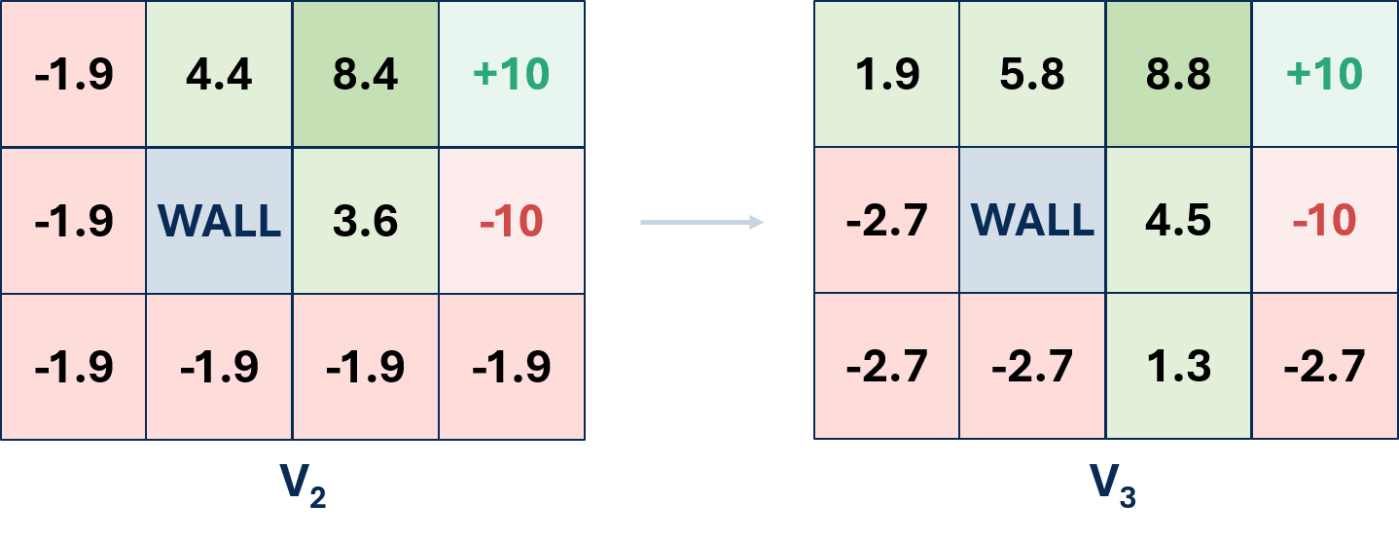
Value propagates backward through the state space
The heat map tells the story of repeated Bellman backups.
Each sweep lets future reward influence states farther away.
CS 471 | L13: Value Iteration
22
Notes:
Use this conceptual slide to explain why one sweep is not enough. Values become more informed as reward information propagates.

Slide 23
Values are not rewards
A state can have low immediate reward and high long-term value.
3.1
6.5
9.0
+10
Immediate reward
Moving through ordinary cells still costs about −1.
-0.2
WALL
4.9
-10
State value
This state can lead toward +10, so its long-term value is positive.
-3.4
-0.6
1.7
-1.2
Example state
Reward answers “what happened now?”
Value answers “what should I expect from here?”
CS 471 | L13: Value Iteration
23

Slide 24
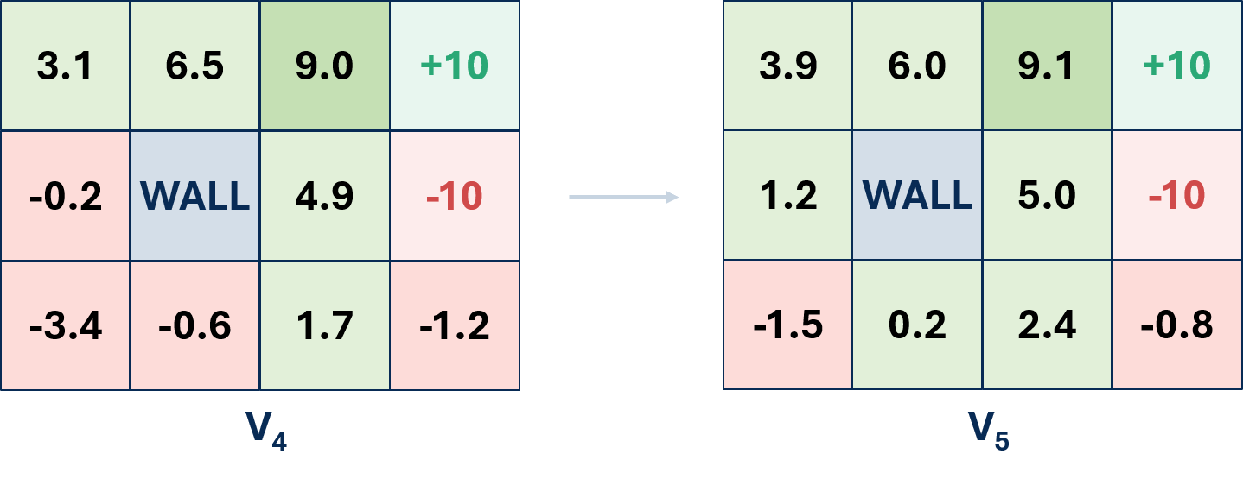
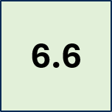
What convergence looks like
The estimates change a lot early and only a little later.
A sample cell: 4.4 → 5.8 → 6.5 → 6.6
Successive heat maps become less different.
CS 471 | L13: Value Iteration
24

Slide 25
Measure change with Δ
Convergence needs a stopping signal.
$$Δ = \max_{s}\left|Vₖ₊₁(s) − Vₖ(s)\right|$$
Interpretation
Δ is the largest state-value change in the latest sweep.
Example
If Δ = 0.0007 and θ = 0.001, stop because Δ < θ.
Small Δ means the repeated updates are no longer changing the values much.
CS 471 | L13: Value Iteration
25
Notes:
Explain delta as the largest absolute change. Students only need to interpret convergence, not prove it. Link to GR2: values changing by at most a very small number suggests convergence. Do not overstate; it depends on the tolerance.

Slide 26
Convergence means stability, not magic
Values usually do not become exactly unchanged in finite time.
Not convergence
Every value must be exactly identical
The agent has experienced the environment
Rewards disappear
The math becomes deterministic
Convergence
Value estimates are sufficiently stable
Further sweeps change little
The tolerance tells us when to stop
The resulting values support action choice
We stop when the values are stable enough for the chosen tolerance.
CS 471 | L13: Value Iteration
26

Slide 27
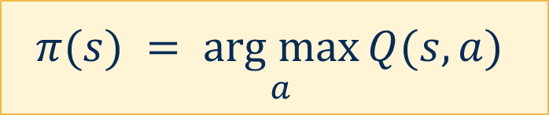
Values reveal a greedy policy
Once values stabilize, choose the action with the highest Bellman action value.
↑
3.9
→
6.6
→
9.1
→
+10
5.0
4.2
s
-2.1
1.2
↑
WALL
5.0
↑
-10
1.3
-1.5
→
0.2
→
2.4
↑
-0.8
←
$$π(s) = \underset{a}{arg max}{Q(s,a)}$$
Stabilized values + greedy arrows
The arrow is not guessed. It comes from comparing action values.
CS 471 | L13: Value Iteration
27
Notes:
Connect to L12: greedy means select the action with the highest estimated long-term value, not the highest immediate reward.

Slide 28
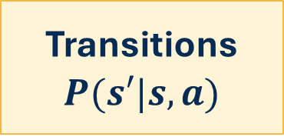
Value iteration is model-based
Every backup used a model of how actions may turn out.
States
S
Actions
A
Transitions
$$P(s′|s,a)$$
Rewards
R
If transition probabilities are unknown,
this exact Bellman expectation calculation cannot be performed.
That question will return in Q-learning.
CS 471 | L13: Value Iteration
28
Notes:
State the model-based requirement. Save a fuller model-based vs model-free comparison for L15.

Slide 29
Practice: Bellman update sprint
Show substitution, compute, compare, interpret.
action: Reserve
at state: Z
immediate reward: +2
70% → X, V(X)=5
30% → Y, V(Y)=1
γ = 0.6
Q(Z, Reserve) = 2 + 0.6[0.7(5)+0.3(1)]
= 4.28
Compare
If Q(Z, Alternate)=4.60, which action is greedy?
What does 4.28 mean?
Compute → Interpret → Predict.
CS 471 | L13: Value Iteration
29
Notes:
Have students do the weighted average first, then the discount, then add reward. Finally compare to a supplied second action value.

Slide 30
Practice: diagnose Bellman mistakes
Which statements are correct? Which misconception do they reveal?
A
Choose the most likely next state and ignore the others.
Wrong: use expected value.
B
Choose the action with the largest immediate reward.
Wrong: compare Bellman action values.
C
During a synchronous sweep, use Vₖ values to compute Vₖ₊₁.
Correct for our convention.
D
Tiny value changes suggest convergence if below the threshold.
Reasonable.
Common errors usually come from confusing chance, control, and time.
CS 471 | L13: Value Iteration
30
Notes:
Use as fast partner discussion. Ask pairs to select one claim and explain why it is wrong.

Slide 31
Read value iteration
Map the code to the visual process.
initialize V
repeat:
delta = 0
for each state s:
compute return for every action
V_new[s] = largest action value
update delta
V = V_new
until delta is small
Code idea
Visual meaning
compute return
Predict + evaluate
largest action value
Agent takes MAX
update delta
Measure change
repeat
Propagate farther
Question to ask: which part handles chance, and which part handles choice?
CS 471 | L13: Value Iteration
31
Notes:
Connect to code interpretation. Students are not writing code; they are identifying the role of max and delta.

Slide 32
Exit ticket: rebuild value iteration
Use the concept chain, not just the formula.
Expected future value combines _______________________.
Bellman action value adds _______________________.
V(s) uses the __________ action value.
Repeated sweeps allow value to _______________________.
Very small changes suggest _______________________.
Preview L14: What if we explicitly hold a policy fixed, evaluate it, then improve it?
CS 471 | L13: Value Iteration
32

